Slide 1
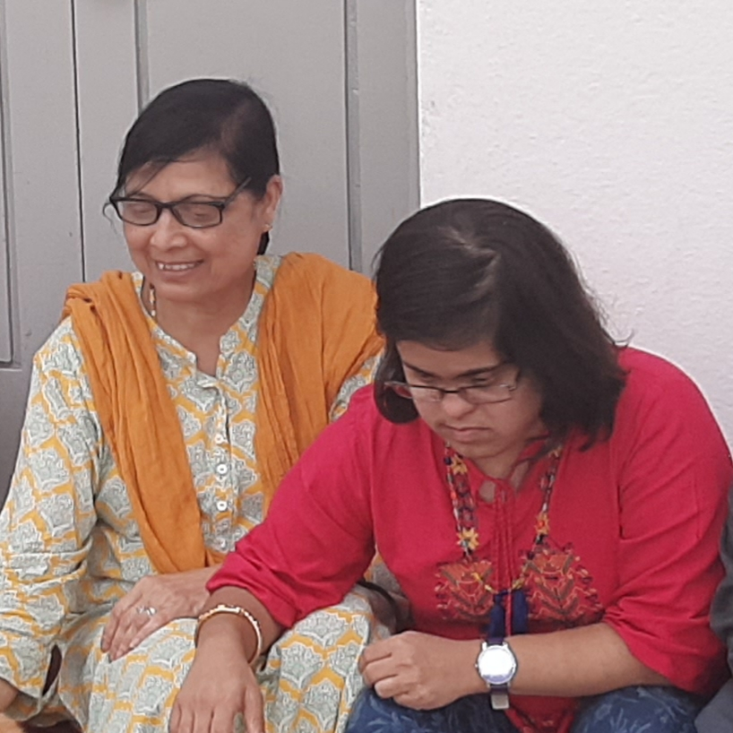
MY INSPIRATION
This is a story of a mother who strived against all odds, which destiny gave her.
Esther Thomas had great hopes for Divya when she came as a new member into her life, but soon she discovered that Divya is not like a normal kids, Esther came to know that her little daughter Divya is a child with down syndrome.
It took seven precious years to cope with the fact that her daughter is a child with down syndrome, but she dint loose hope, when Divya was seven years, Esther joined for a course under Karnataka parents association of mentally retarde children, later she understood her daughter better and supported her, then onwards for more than nine years she worked in number of special schools.
Army special school (1998-2001)
Bethany special school (2001-2003)
in these years she visited places like NIMH, Mathru Mandir downs research society ,the first Indian institute for DS in Chennai started by Rekha Ramachandran, she received all the teaching materials needed for training DS, and finally on 10th Oct 2003 she laid the foundation of Divya downs development trust, DDDT was launched on June 7th 2004, she started with four children now DDDT has more than 25 children who receive training and care to lead a normal life.

